Slide 1


Sachi D Wijeratne
5th April 2024

Slide 2

Outline
Executive Summary
Introduction
Methodology
Results
Conclusion
Appendix

Slide 3
Executive Summary
Summary of methodologies
Data was collected from the SpaceX public API and publically available data on Wikipedia. Data wrangling included extracting launch outcome information to serve as the dependent variable in the Machine Learning models.
SQL queries and data visualizations (static plots, interactive maps, and an interactive dashboard) were created to discover insights about the data set and answer questions.
Predictive analysis was pursued using Logistic Regression, SVM (Support Vector Machine), Decision Tree, and KNN (k-nearest Neighbors) Machine Learning models.
Summary of all results
Launch data include info about flight number, date of launch, payload mass, orbit type, launch site, mission outcome and other variables.
Logistic Regression, SVM (Support Vector Machine), and KNN (k-nearest Neighbors) all perform equally well for Machine Learning models on this dataset.

Slide 4
Introduction
In competition with SpaceX, a rival rocket launch company wants to make predictions about the success/failure of SpaceX Falcon 9 rocket first-stage landings.
What is the nature and extent of the data that we have on SpaceX Falcon 9 first-stage landings?
Which machine learning model would work best (have the highest accuracy) to predict the outcome of a Falcon 9 first-stage landing from a future launch?
Will a future Falcon 9 first-stage landing be successful?

Slide 5

Section 1

Slide 6
Methodology
Executive Summary
Data collection methodology:
From SpaceX API and Wikipedia launch table data
Perform data wrangling
Data was cleaned in preparation for visualizations, queries, and machine learning model creation
Perform exploratory data analysis (EDA) using visualization and SQL
Perform interactive visual analytics using Folium and Plotly Dash
Perform predictive analysis using classification models

Slide 7
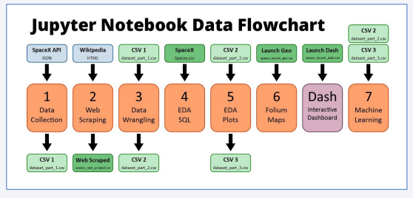
Data Collection
The data sets were collected from:
An IBM copy of a call to the publically accessible SpaceX API with launch data in JSON format.
A permanently linked Wikipedia page with launch data in HTML tables (9 June 2021 revision).
Further data sets were provided.

Slide 8
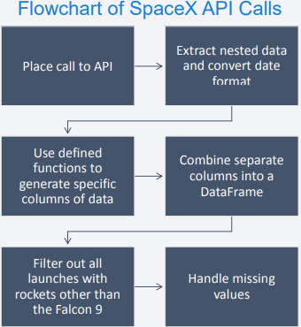
Data Collection – SpaceX API
The SpaceX API has data available publically.
Once a GET request has been made to the SpaceX API and the response received, the data can be placed into a Pandas DataFrame for further analysis.
https://github.com/SachiWijeratne/DSCertIBM_CapstoneProject/blob/main/jupyter-labs-spacex-data-collection-api.ipynb

Slide 9
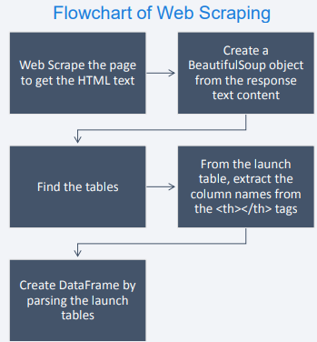
Data Collection - Scraping
Wikipedia has a page that has tables of data about SpaceX launches.
These tables can be scraped to extract launch data that can be put into a Pandas DataFrame for further analysis.
https://github.com/SachiWijeratne/DSCertIBM_CapstoneProject/blob/main/jupyter-labs-webscraping.ipynb

Slide 10
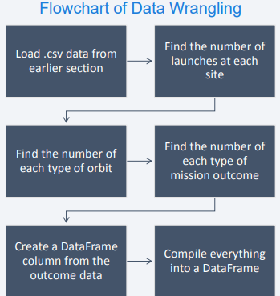
Data Wrangling
The .csv file from the first section contains the data that needed to be cleaned.
The launch sites, orbit types and mission outcomes were cleaned up.
The handful of mission outcome types were converted to a binary classification where 1 means that the Falcon 9 first stage landing was a success and 0 means that it was a failure.
The new classification was added to the DataFrame for further analysis
https://github.com/SachiWijeratne/DSCertIBM_CapstoneProject/blob/main/labs-jupyter-spacex-Data%20wrangling.ipynb

Slide 11
EDA with Data Visualization
The following charts were created to look at Launch Site trends
Scatterplot to see mission outcome relationship split by Launch Site and Flight Number.
Scatterplot to see mission outcome relationship split by Launch Site and Payload.
The following charts were created to look at Orbit Type trends
Bar chart to see mission outcome relationship with Orbit Type.
Scatterplot to see mission outcome relationship split by Orbit Type and Flight Number.
Scatterplot to see mission outcome relationship split by Orbit Type and Payload.
The following chart was created to look at trends based on time
Line plot to see mission outcome trend by year.
• GitHub URL : https://github.com/SachiWijeratne/DSCertIBM_CapstoneProject/blob/main/edadataviz.ipynb

Slide 12
EDA with SQL
Queries were written to extract information about:
Launch sites
Payload masses
Dates
Booster types
Mission outcomes
GitHub URL (EDA with SQL):
https://github.com/SachiWijeratne/DSCertIBM_CapstoneProject/blob/main/jupyter-labs-eda-sql-coursera_sqllite.ipynb

Slide 13
Build an Interactive Map with Folium
Summarize what map objects such as markers, circles, lines, etc. you created and added to a folium map
Markers were added for launch sites and for the NASA Johnson Space Center
Circles were added for the launch sites.
Lines were added to show the distance to the nearby features:
Distance from CCAFS LC-40 to the coastline
Distance from CCAFS LC-40 to the rail line
Distance from CCAFS LC-40 to the perimeter road
GitHub URL (Folium Maps):
https://github.com/SachiWijeratne/DSCertIBM_CapstoneProject/blob/main/lab_jupyter_launch_site_location.ipynb

Slide 14
Build a Dashboard with Plotly Dash
The input dropdown is used to select one or all launch sites for the pie chart and scatterplot.
The pie chart displays one of two things:
For All Sites –the distribution of successful Falcon 9 first stage landings between the sites
For One Site –the distribution of successful and failed Falcon 9 first stage landings for that site
The input slider is used to filter the payload masses for the scatterplot.
The scatterplot displays the distribution of Falcon 9 first stage landings split by payload mass, mission outcome and by booster version category.

Slide 15
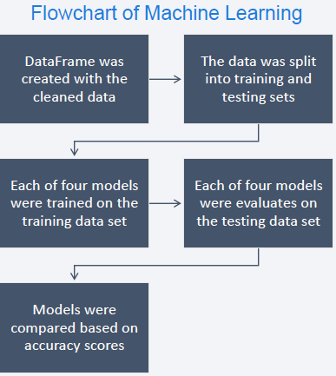
Predictive Analysis (Classification)
The dataset was split into training and testing sets.
Logistic Regression, SVM (Support Vector Machine), Decision Tree, and KNN (k-Nearest Neighbors) machine learning models were trained on the training data set.
Hyper-parameters were evaluated using GridSearchCV() and the best was selected using ‘.best_params_’.
Using the best hyper-parameters, each of the four models were scored on accuracy by using the testing data set.
https://github.com/SachiWijeratne/DSCertIBM_CapstoneProject/blob/main/SpaceX_Machine%20Learning%20Prediction_Part_5.ipynb

Slide 16
Results
Exploratory data analysis results
Interactive analytics demo in screenshots
Predictive analysis results

Slide 17

Section 2

Slide 18
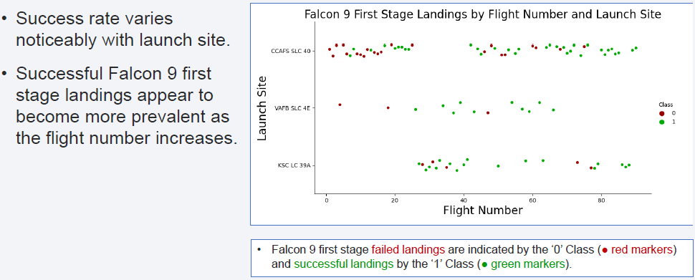
Flight Number vs. Launch Site

Slide 19
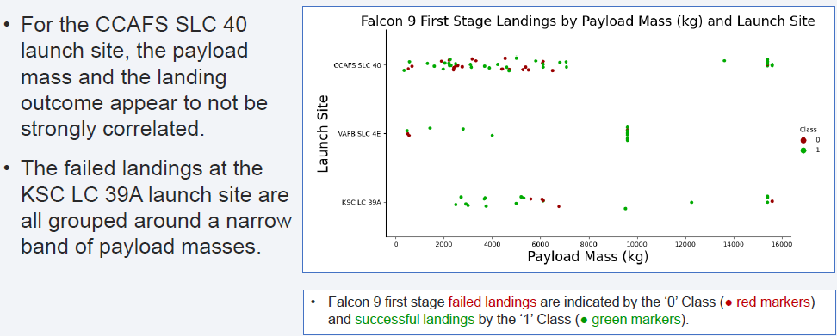
Payload vs. Launch Site

Slide 20
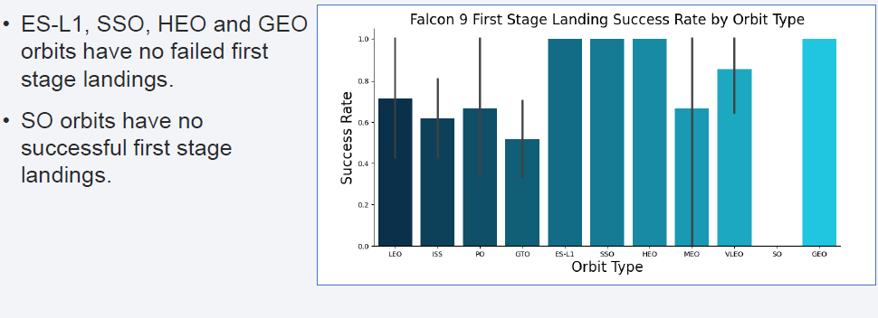
Success Rate vs. Orbit Type

Slide 21
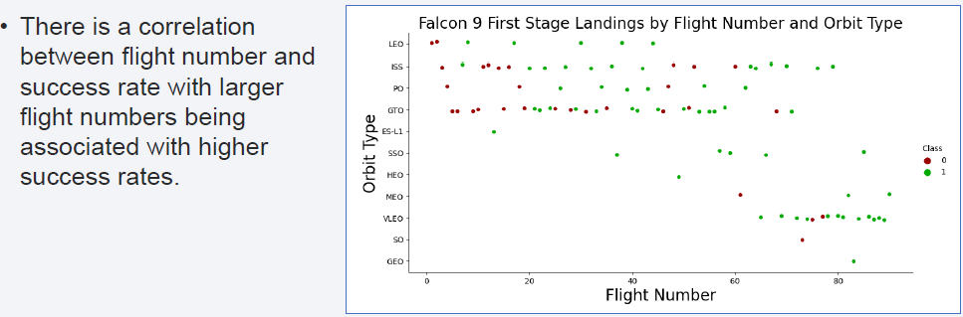
Flight Number vs. Orbit Type

Slide 22
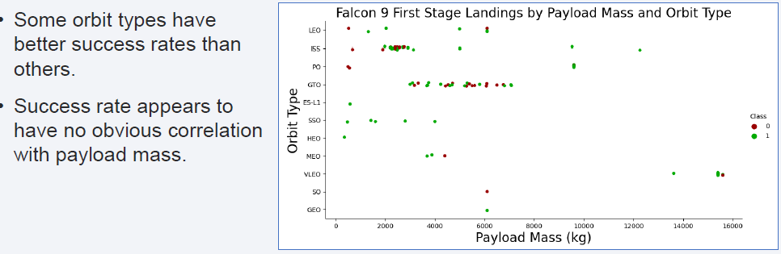
Payload vs. Orbit Type

Slide 23
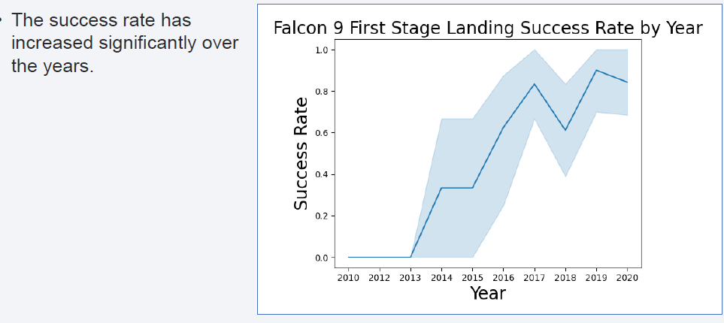
Launch Success Yearly Trend

Slide 24
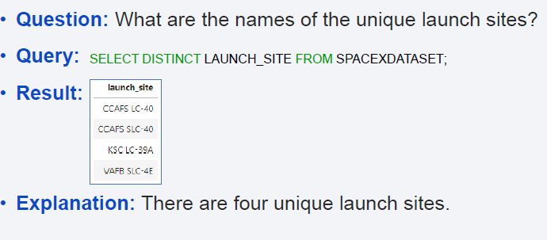
All Launch Site Names

Slide 25
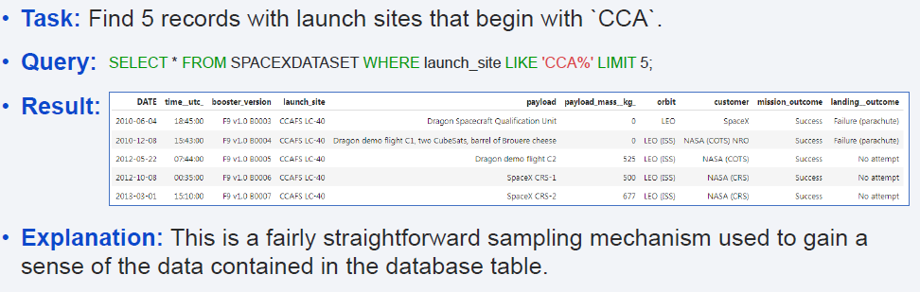
Launch Site Names Begin with 'CCA'

Slide 26
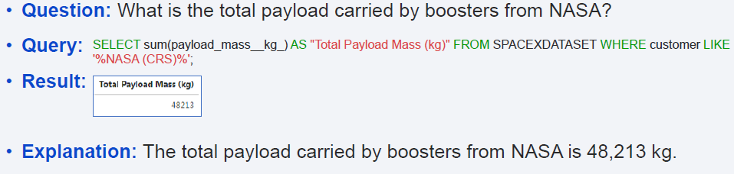
Total Payload Mass

Slide 27
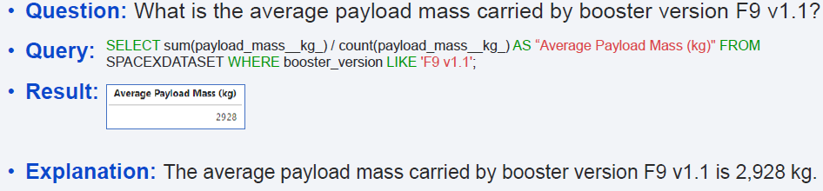
Average Payload Mass by F9 v1.1

Slide 28
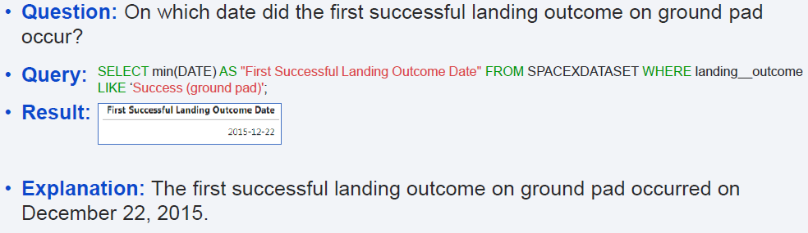
First Successful Ground Landing Date

Slide 29
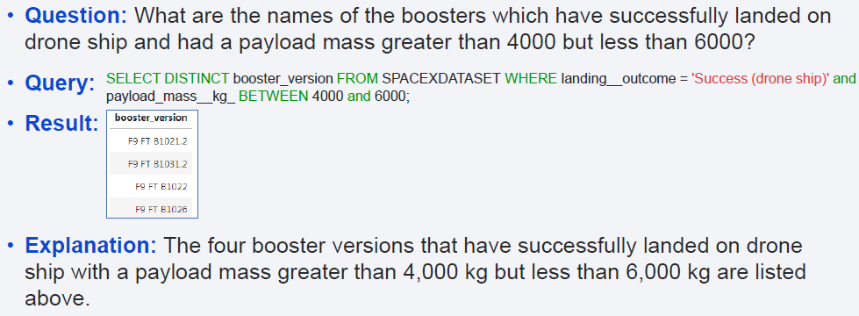
Successful Drone Ship Landing with Payload between 4000 and 6000

Slide 30
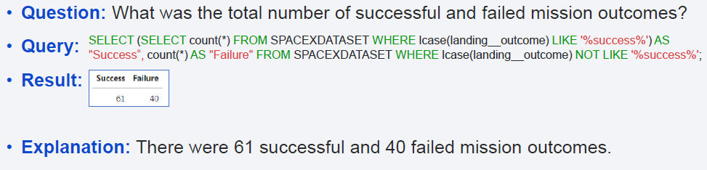
Total Number of Successful and Failure Mission Outcomes

Slide 31
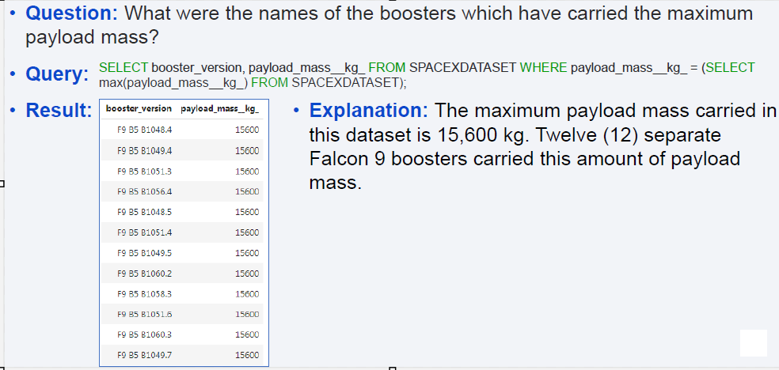
Boosters Carried Maximum Payload

Slide 32
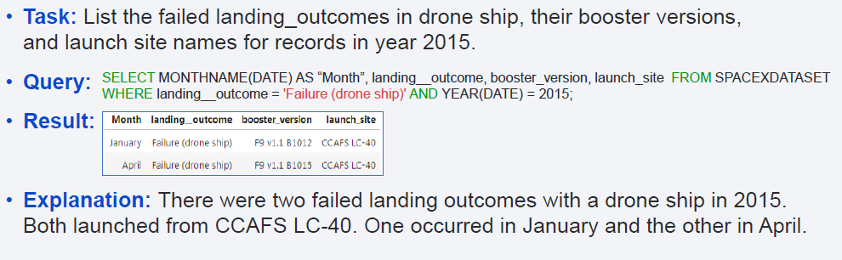
2015 Launch Records

Slide 33
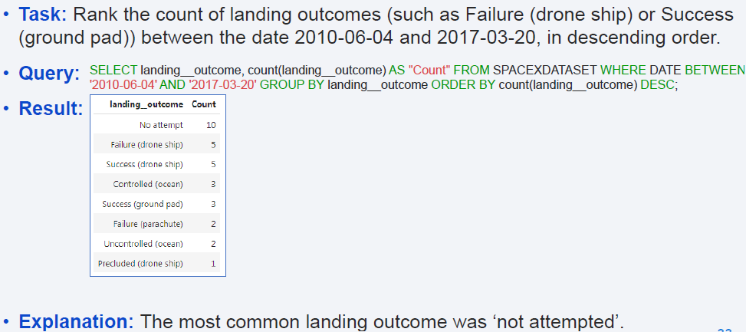
Rank Landing Outcomes Between 2010-06-04 and 2017-03-20

Slide 34

Section 3

Slide 35
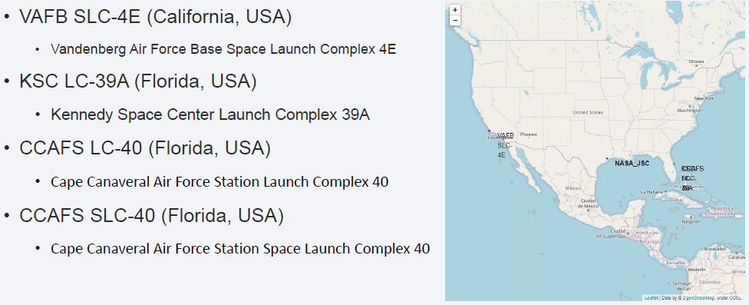
<Folium Map Screenshot 1>

Slide 36
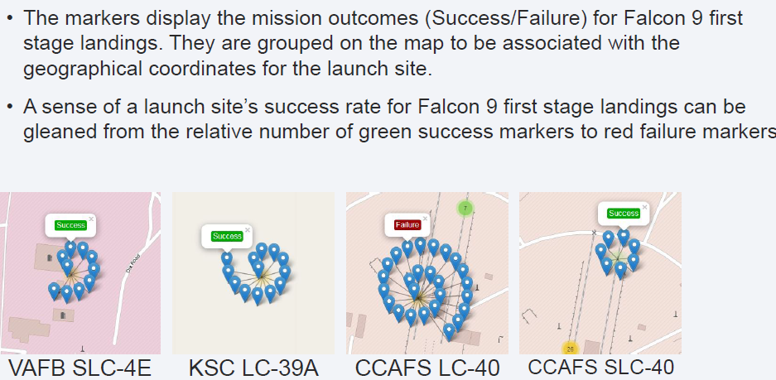
<Folium Map Screenshot 2>

Slide 37
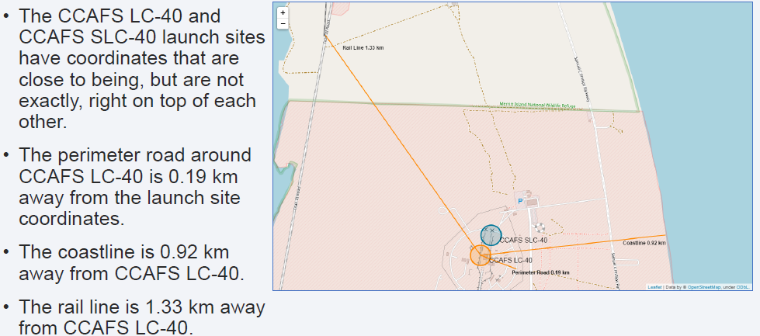
<Folium Map Screenshot 3>

Slide 38

Section 4

Slide 39
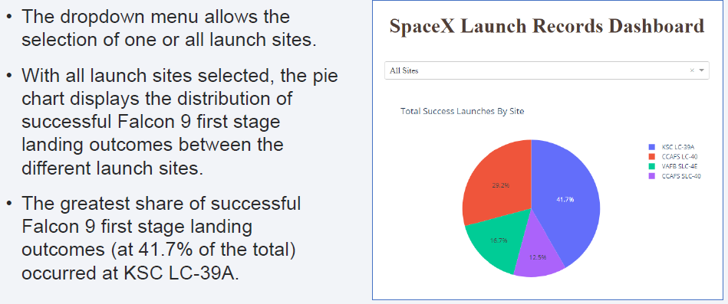
<Dashboard Screenshot 1>

Slide 40
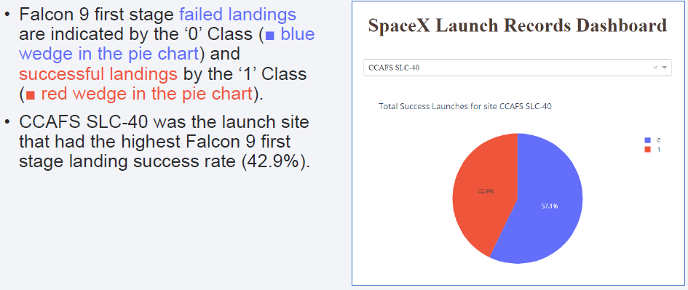
<Dashboard Screenshot 2>

Slide 41
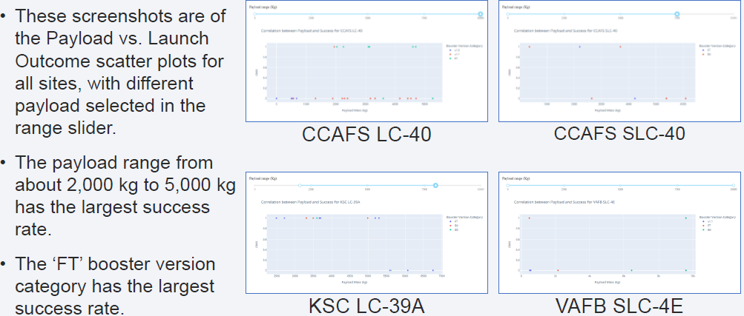
<Dashboard Screenshot 3>

Slide 42

Section 5

Slide 43
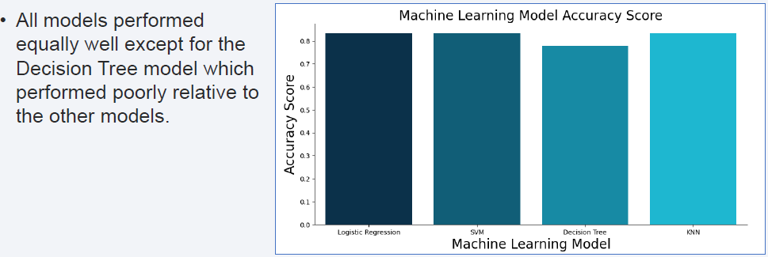
Classification Accuracy

Slide 44
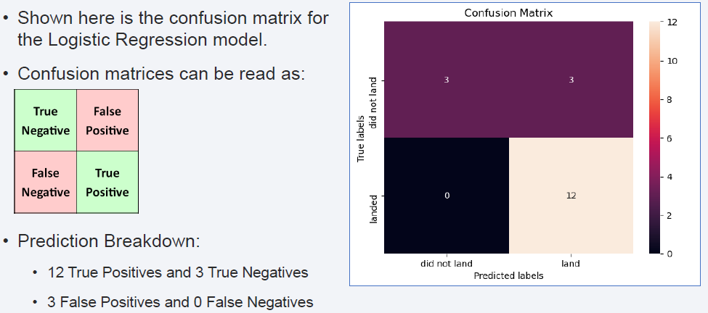
Confusion Matrix

Slide 45
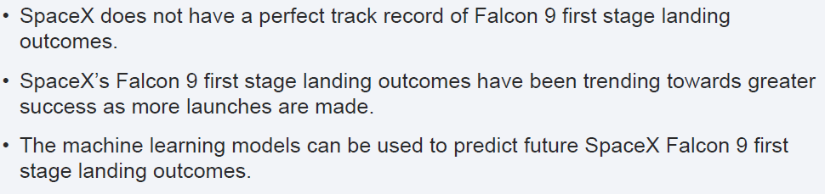
Conclusions

Slide 46


